Slide 1


Mang’oli Martin
19 September 2022

Slide 2

Outline
Executive Summary
Introduction
Methodology
Results
Conclusion
Appendix

Slide 3
Executive Summary
This project involved coming up with a data science model that predicts whether a rocket will land successfully during the first launch. Successful first stage landing enables SpaceX to reuse it during the subsequent launches hence reducing the cost of rocket launches by more than 100 million dollars.
We collected data of the previous launches from the SpaceX website through their APIs to enable us predict the outcome of the launch.
After cleaning the data we subjected it to four machine learning algorithms: Logistic Regression, Support Vector Machines, Decision Tree, and K Nearest Neighbors.
All the algorithms gave higher accuracy except Decision Tree. Therefore the company could rely on either of the three models to predict whether the first launch will be successful or not.

Slide 4
Introduction
Space X advertises Falcon 9 rocket launches on its website with a cost of 62 million dollars; other providers cost upward of 165 million dollars each, much of the savings is because Space X can reuse the first stage.
Therefore if we can determine if the first stage will land, we can determine the cost of a launch. This information can be used if an alternate company wants to bid against space X for a rocket launch.
In this project, we created a machine learning pipeline to predict if the first stage will land given the data from the previous launches.

Slide 5

Section 1

Slide 6
Methodology
Executive Summary
Data collection methodology:
We collected data on the characteristics of the Falcon 9 rockets from SpaceX website using their APIS.
We also collected Falcon 9 historical launch records from a Wikipedia page by performing web scraping.
Perform data wrangling
We replaced missing values in the Payload column with the average mass of the payload.
Perform exploratory data analysis (EDA) using visualization and SQL
Perform interactive visual analytics using Folium and Plotly Dash
Perform predictive analysis using classification models
How to build, tune, evaluate classification models

Slide 7
Data Collection
One set of data about characteristics of Falcon 9 rockets was collected from SpaceX website using their own APIs.
Data on historical launches whether they were successful or not was collected from Wikipedia through web scrapping.

Slide 8
Data Collection – SpaceX API
SpaceX website has several API end points that we accessed to get the needed information:
Rockets API gives the booster name
Launchpads API gives the site being used, the longitude, and the latitude
Payloads API gives the mass of the payload and the orbit that it is going to
Cores API gives the core data about the rocket
Past API gives the past launch data
The GitHub URL of the completed SpaceX API calls notebook (https://github.com/mangsmato/IBM-Applied-Data-Science-Capstone/blob/master/Data%20Collection%20API.ipynb)
SpaceX website
API Calls
Data on Falcon 9 rocket (booster version, payload, launch site, etc)

Slide 9
Data Collection - Scraping
Using requests and BeatifulSoup libraries we performed web scraping to collect Falcon 9 historical launch records from a Wikipedia page titled List of Falcon 9 and Falcon Heavy launches
The GitHub URL of the completed web scraping notebook (https://github.com/mangsmato/IBM-Applied-Data-Science-Capstone/blob/master/Data%20Collection%20with%20Web%20Scraping.ipynb)
Wikipedia page
Web scrapping
Historical Falcon 9 launches

Slide 10
Data Wrangling
Once we got the data from the SpaceX API calls we filtered it to contain only Falcon 9 launches.
We left the LandingPad column to retain missing values to represent when landing pads were not used.
We replaced missing values on the payload data with the average payload mass.
The GitHub URL of the data wrangling on SpaceX API calls notebook (https://github.com/mangsmato/IBM-Applied-Data-Science-Capstone/blob/master/Data%20Collection%20API.ipynb)

Slide 11
EDA with Data Visualization
Using a scatter plot we noted that as the flight number increases, the first stage is more likely to land successfully.
The more massive the payload, the less likely the first stage will return.
It also showed VAFB SLC 4E launch site had the best success rate with a few flights. The success rate at CCAFS LC-40 launch site is low compared to the other two launch sites (KSC LC-39A and VAFB SLC 4E) hence there's need to increase the number of lights for the launch to be successful.
With heavy payloads the successful landing or positive landing rate are more for Polar,LEO and ISS orbits.
A bar chart enabled us to know that ES-L1, GEO, HEO, and SSO orbits had high success rates.
A line graph showed an increase in the success rate since 2013 till 2020
The GitHub URL of the ompleted EDA with data visualization notebook (https://github.com/mangsmato/IBM-Applied-Data-Science-Capstone/blob/master/EDA%20with%20Data%20Visualization.ipynb)

Slide 12
EDA with SQL
select * from cnm23816.spacexdataset to extract the entire dataset
select distinct launch_site from cnm23816.spacexdataset to display the names of the unique launch sites in the space mission.
select * from cnm23816.spacexdataset where upper(launch_site) like 'CCA%’ LIMIT 5 to display 5 records where launch sites begin with the string 'CCA’.
select SUM(payload_mass__kg_) total_payload_mass from cnm23816.spacexdataset WHERE UPPER(customer) = 'NASA (CRS)’ to display the total payload mass carried by boosters launched by NASA (CRS).
select AVG(payload_mass__kg_) average_payload_mass from cnm23816.spacexdataset where upper(booster_version) like 'F9 V1.1’ to display average payload mass carried by booster version F9 v1.1.
select MIN(DATE) MIN_DATE from cnm23816.spacexdataset where landing__outcome = 'Success (ground pad)’ to List the date when the first successful landing outcome in ground pad was achieved.
select DISTINCT booster_version from cnm23816.spacexdataset where landing__outcome = 'Success (drone ship)’ AND payload_mass__kg_ > 4000 AND payload_mass__kg_ < 6000 to List the names of the boosters which have success in drone ship and have payload mass greater than 4000 but less than 6000
select mission_outcome, COUNT(*) outcomes from cnm23816.spacexdataset GROUP BY mission_outcome to list the total number of successful and failure mission outcomes
select DISTINCT booster_version, payload_mass__kg_ from cnm23816.spacexdataset where payload_mass__kg_ = (select MAX(payload_mass__kg_) from cnm23816.spacexdataset) to List the names of the booster_versions which have carried the maximum payload mass.
select DATE, landing__outcome, booster_version, launch_site from cnm23816.spacexdataset where landing__outcome = 'Failure (drone ship)’ and year(DATE) = 2015 to List the failed landing_outcomes in drone ship, their booster versions, and launch site names for in year 2015.
select landing__outcome, COUNT(*) outcomes from cnm23816.spacexdataset where date between '2010-06-04' and '2017-03-20’ GROUP BY landing__outcome ORDER BY COUNT(*) DESC to Rank the count of landing outcomes (such as Failure (drone ship) or Success (ground pad)) between the date 2010-06-04 and 2017-03-20, in descending order
The GitHub URL of the completed EDA with SQL notebook (https://github.com/mangsmato/IBM-Applied-Data-Science-Capstone/blob/master/EDA%20with%20SQL.ipynb)

Slide 13
Build an Interactive Map with Folium
Added the following map objects to the folium map:
Added each site's location on a map using site's latitude and longitude coordinates.
Added a circle for each launch site in the data frame.
Created markers for all launch records. If a launch was successful (class=1), then we used a green marker and if a launch was failed, we used a red marker (class=0)
Drew lines between a launch site to its closest city, railway, highway, coastline to explore and analyze the proximities of launch sites.
The GitHub URL of the completed interactive map with Folium map (https://github.com/mangsmato/IBM-Applied-Data-Science-Capstone/blob/master/Interactive%20Visual%20Analytics%20with%20Folium.ipynb)

Slide 14
Build a Dashboard with Plotly Dash
Added the following plots/graphs and interactions to the dashboard:
Added a dropdown list to enable Launch Site selection. The default select value is for ALL sites.
Added a pie chart to show the total successful launches count for all sites. If a specific launch site was selected, show the Success vs. Failed counts for the site.
Added a slider to select payload range
Added a scatter chart to show the correlation between payload and launch success
The GitHub URL of the completed Plotly Dash (https://github.com/mangsmato/IBM-Applied-Data-Science-Capstone/blob/master/spacex_dash_app.py)

Slide 15
Predictive Analysis (Classification)
Summarize how you built, evaluated, improved, and found the best performing classification model
Imported key libraries (pandas, numpy, scikit-learn, matplotlib) and defined auxiliary functions.
Loaded the data using pandas library.
Split the data into features and labels. Standardized the features.
Split the data into training and testing sets with 80% training and 20% testing.
Trained four classification models using the data: Logistic Regression, Support Vector Machines (SVM), Decision Tree, K Nearest Neighbors (KNN).
Used Grid Search CV to select best parameters for each model.
Using the confusion matrix picked the best model.
The GitHub URL of the completed predictive analysis (https://github.com/mangsmato/IBM-Applied-Data-Science-Capstone/blob/master/SpaceX_Machine%20Learning%20Prediction.ipynb)

Slide 16
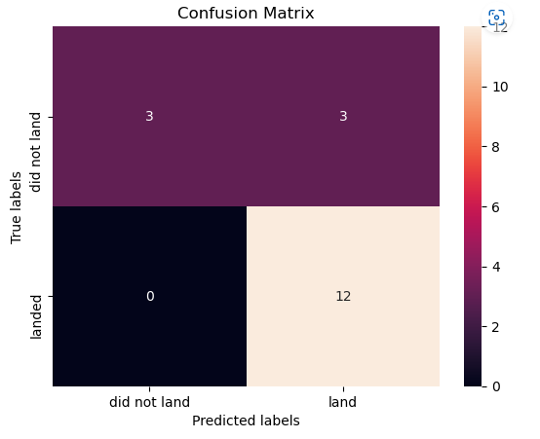
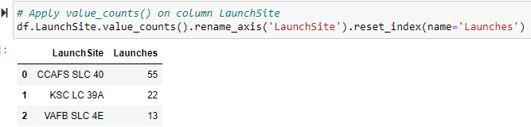
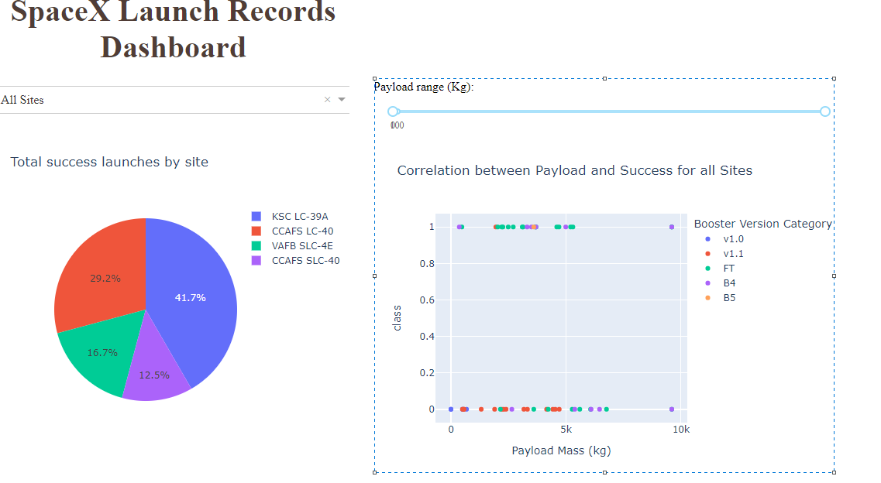
Results
Predictive analysis results.
Exploratory data analysis results
Interactive analytics demo in screenshots

Slide 17

Section 2

Slide 18
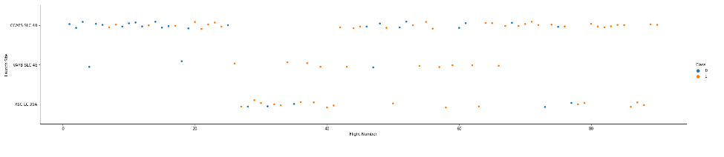
Flight Number vs. Launch Site
A scatter plot of Flight Number vs. Launch Site
The success rate at CCAFS LC-40 is low compared to the other two launch sites (KSC LC-39A and VAFB SLC 4E) hence there's need to increrase the number of lights for the launch to be successful
VAFB SLC 4E has the best success rate with a few flights

Slide 19
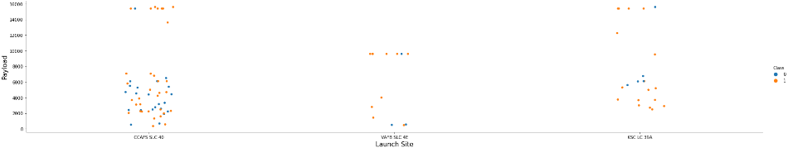
Payload vs. Launch Site
A scatter plot of Payload vs. Launch Site
For the VAFB-SLC launch site there are no rockets launched for heavy payload mass (greater than 10000).

Slide 20
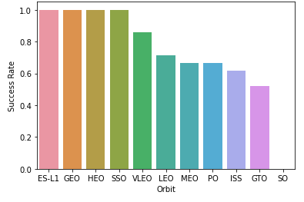
Success Rate vs. Orbit Type
Abar chart for the success rate of each orbit type
The following orbits have a high success rate:
ES-L1
GEO
HEO
SSO

Slide 21
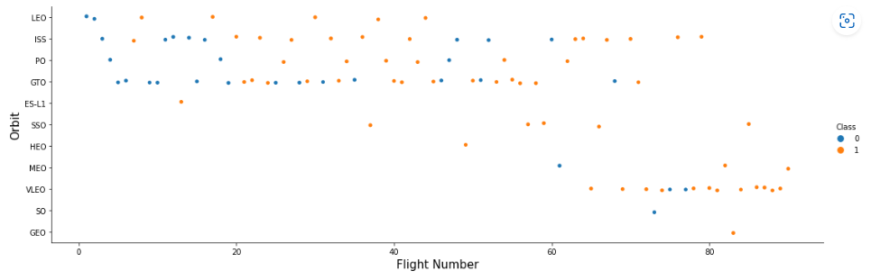
Flight Number vs. Orbit Type
A scatter point of Flight number vs. Orbit type
In the LEO orbit the success appears related to the number of flights; on the other hand, there seems to be no relationship between flight number when in GTO orbit.

Slide 22
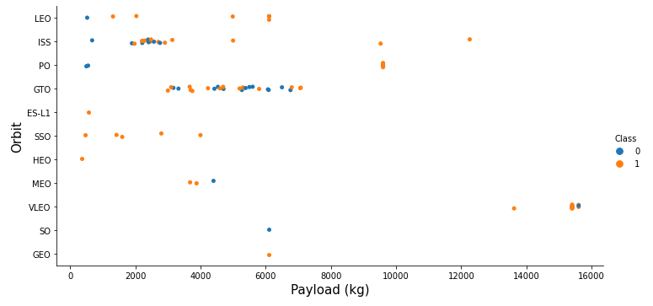
Payload vs. Orbit Type
A scatter point of payload vs. orbit type
With heavy payloads the successful landing or positive landing rate are more for Polar, LEO and ISS.
However for GTO we cannot distinguish this well as both positive landing rate and negative landing(unsuccessful mission) are both there here.

Slide 23
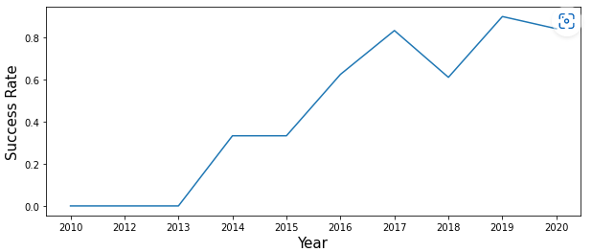
Launch Success Yearly Trend
A line chart of yearly average success rate
The success rate since 2013 kept increasing till 2020

Slide 24
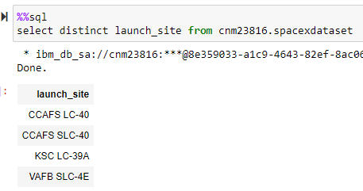
All Launch Site Names
The names of the unique launch sites:

Slide 25
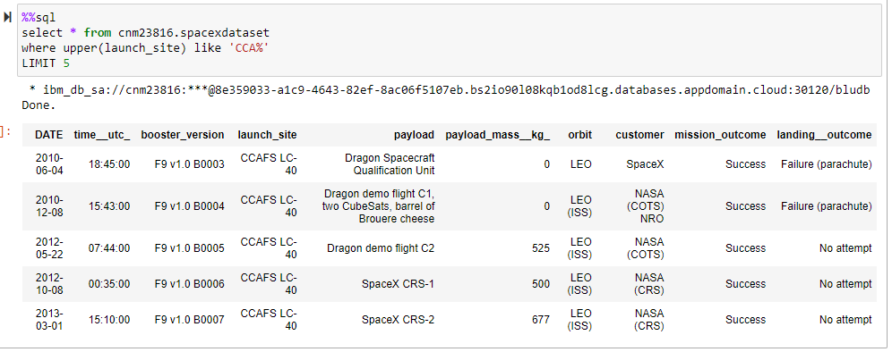
Launch Site Names Begin with 'CCA'
5 records where launch sites begin with `CCA`

Slide 26
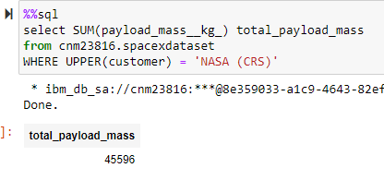
Total Payload Mass
The total payload carried by boosters from NASA

Slide 27
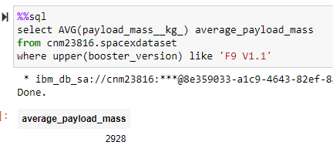
Average Payload Mass by F9 v1.1
The average payload mass carried by booster version F9 v1.1

Slide 28
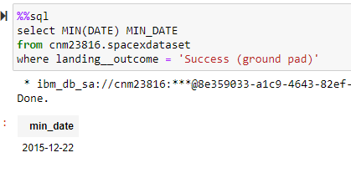
First Successful Ground Landing Date
The dates of the first successful landing outcome on ground pad

Slide 29
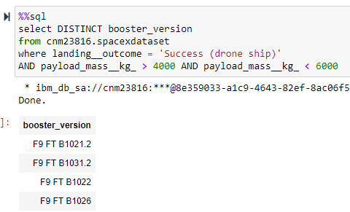
Successful Drone Ship Landing with Payload between 4000 and 6000
The names of boosters which have successfully landed on drone ship and had payload mass greater than 4000 but less than 6000

Slide 30
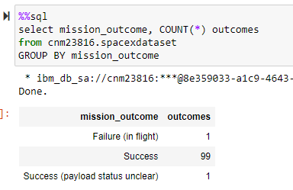
Total Number of Successful and Failure Mission Outcomes
The total number of successful and failure mission outcomes

Slide 31
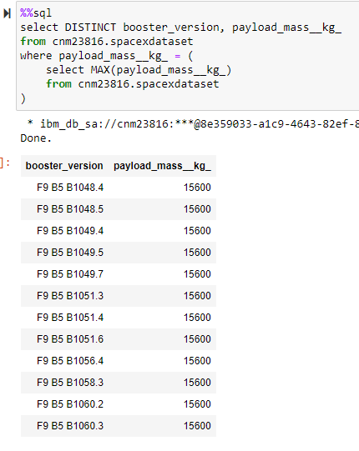
Boosters Carried Maximum Payload
The names of the booster which have carried the maximum payload mass.

Slide 32
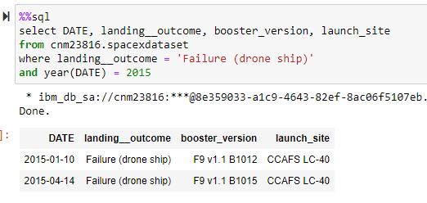
2015 Launch Records
The failed landing_outcomes in drone ship, their booster versions, and launch site names for in year 2015

Slide 33
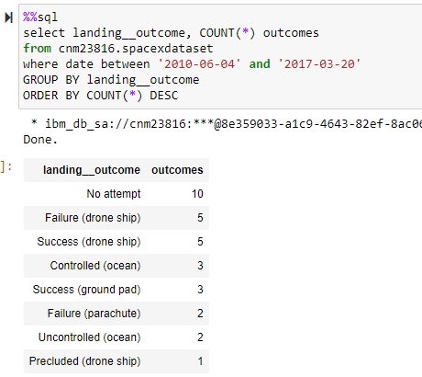
Rank Landing Outcomes Between 2010-06-04 and 2017-03-20
The count of landing outcomes (such as Failure (drone ship) or Success (ground pad)) between the date 2010-06-04 and 2017-03-20, in descending order

Slide 34

Section 3

Slide 35
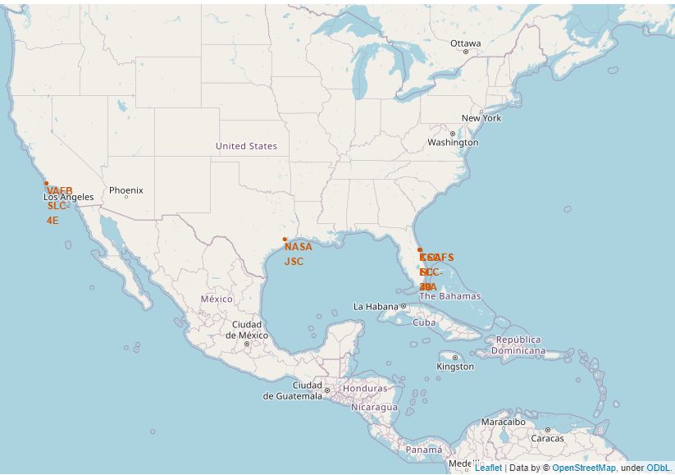
All launch sites on the map

Slide 36
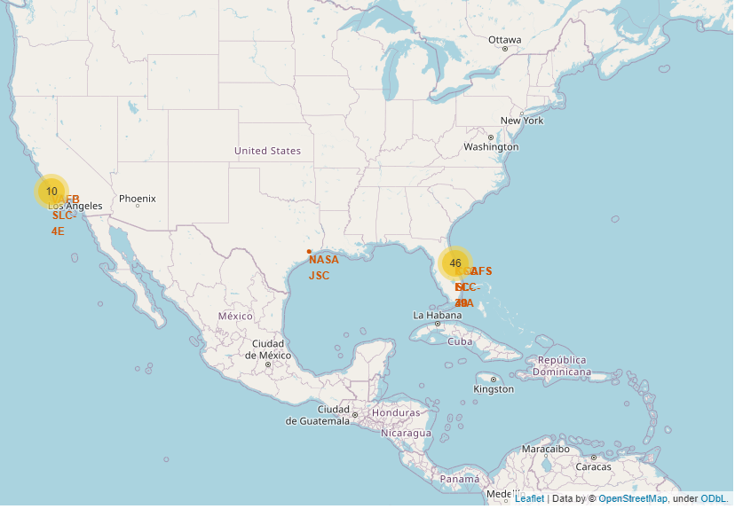
The success/failed launches for each site on the map

Slide 37
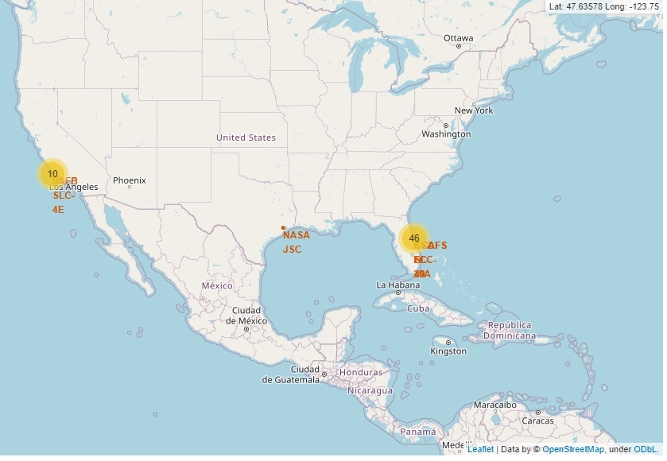
The distances between a launch site to its proximities

Slide 38

Section 4

Slide 39
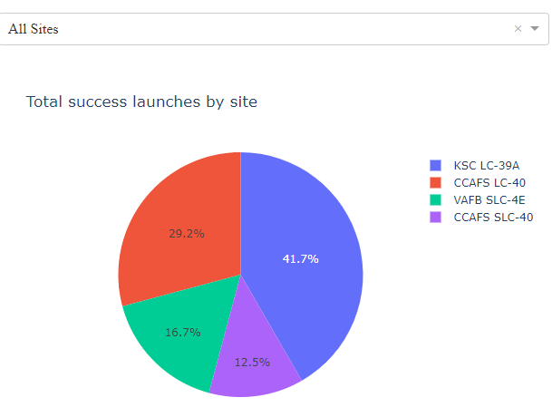
Launch success count for all sites

Slide 40
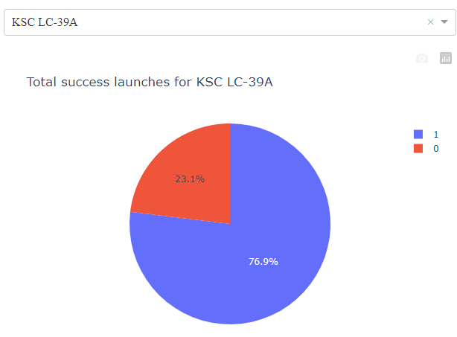
Launch site with highest launch success ratio

Slide 41
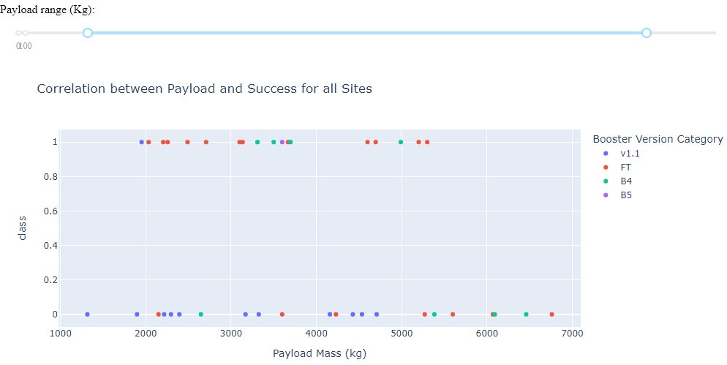
Payload vs. Launch Outcome scatter plot for all sites

Slide 42

Section 5

Slide 43
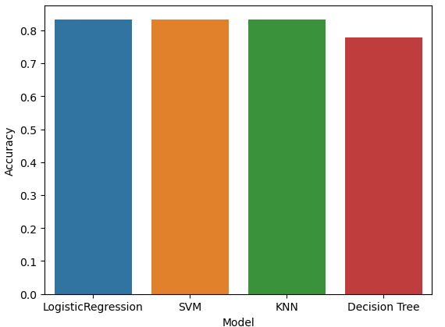
Classification Accuracy
The built model accuracy for all built classification models, in a bar chart
All the models except Decision Tree performed well with an accuracy of 83%

Slide 44
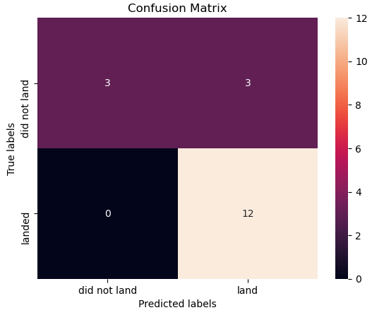
Confusion Matrix
The confusion matrix of the best performing model with an explanation

Slide 45
Conclusions
SpaceX can rely on either Logistic Regression, Support Vector Machines or K-Nearest Neighbors classifiers to predict whether the first launch will be successful or not.
However more model improvement techniques such as feature engineering, data wrangling, etc need to be performed to increase the accuracy of the models.

Slide 46
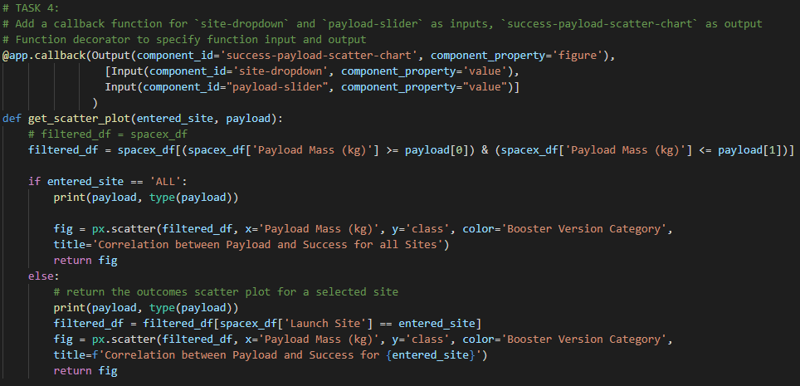
Appendix
Relevant assets like Python code snippets, SQL queries, charts, Notebook outputs, or data sets created during this project.

Slide 47


